Slide 1
eTesting in new masters’ curriculum
Vladimir Valkanov
University of Plovdiv

Slide 2
Education Portal
User Interface
E-Services
Ext Interfaces
Module ‘eLectures’
Module
‘eTesting’
Module
‘Scheduie’
User Profiling
Educational e-Services
IntegrationEngine
SCORM Engine
Test Engine
Event Engine
Digital Libraries
Catalogue
. . .
DLib
DLib
DLib

Slide 3
Module eTesting containing in two parts
Test engine:
Supporting different services;
Contribution with digital libraries;
E-Services:
For different type of users (lecturer, student…) implemented as portlets;
The two parts are supported by Digital Libraries;

Slide 4
Basic e-Services “Test creation”
Actor : lecturer
Service: constructing question
Choosing from 5 basic types;
Using multi-level meta-data;
Service: constructing templates -group of questions based on meta-data;
Service: constructing test
Combining questions and templates;

Slide 5
Basic eServices “Test generation”
Actor: Test engine
Service: test generation
“Unique” test ;
Contributing other eServices;
Actor: Test engine/Software agent
Service: automatic test verification
Depending on question type;
“human” intervention is needed;

Slide 6
Last year experience
In bachelor programs:
Examined 418 students;
Disciplines : Java, DB, AI, SE, English;
In SE master program:
80 students;
All exams are made with eTesting;

Slide 7
Last year experience
About 3000 tests are solved;
It looks easier for the students;
But same results;
System behaviour:
93% of the tests completed successfully;
Most of the problems are already solved;
1% > of test still failed;

Slide 8
Current work
Implementing QTI 2.1 in Test engine
Provide a well documented content format for storing and exchanging items independent of the authoring tool used to create them.
Support the deployment of item banks across a wide range of learning and assessment delivery systems.
Provide a well documented content format for storing and exchanging tests.
Support the deployment of items, item banks, and tests from diverse sources in a single learning or assessment delivery system.
Provide systems with the ability to report test results in a consistent manner.

Slide 9
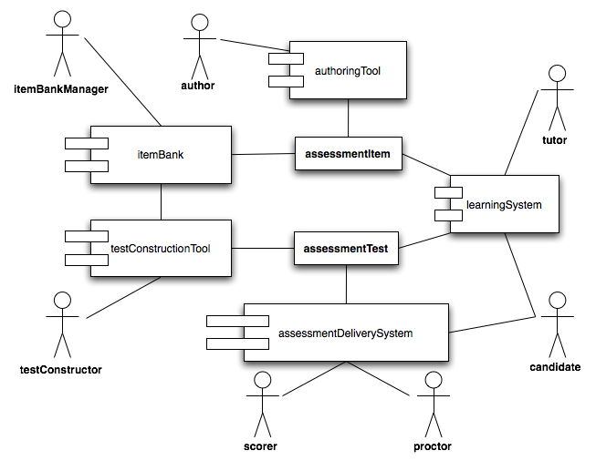
QTI Roles

Slide 10
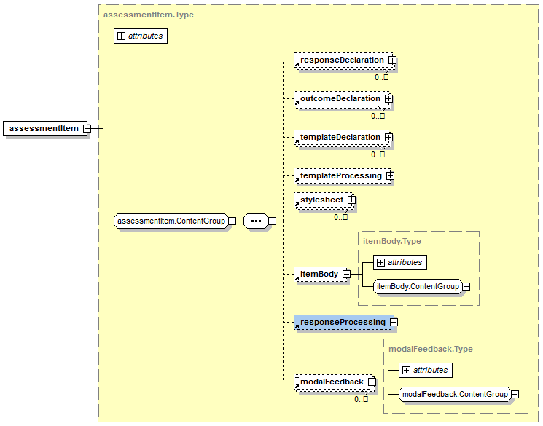
QTI Assessment Item Structure

Slide 11
THANK YOU FOR YOUR ATTENTION

